Slide 1
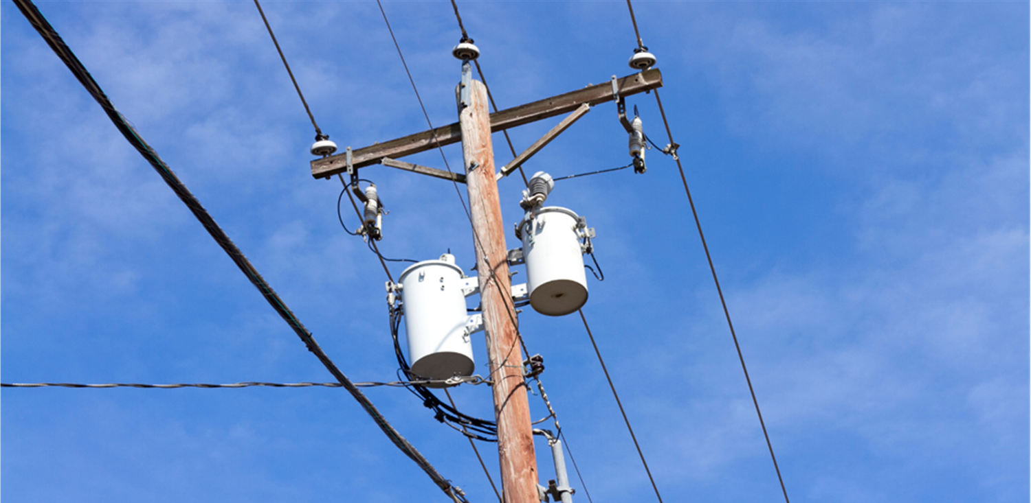
VDR1
Team 510

Slide 2
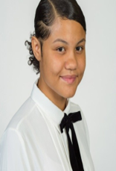
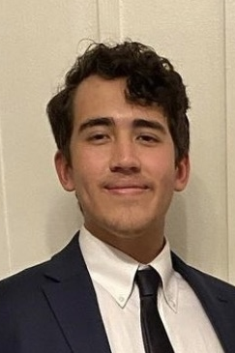
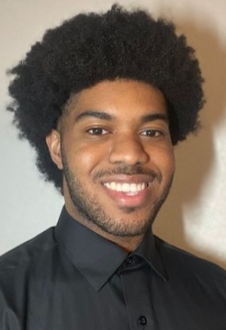
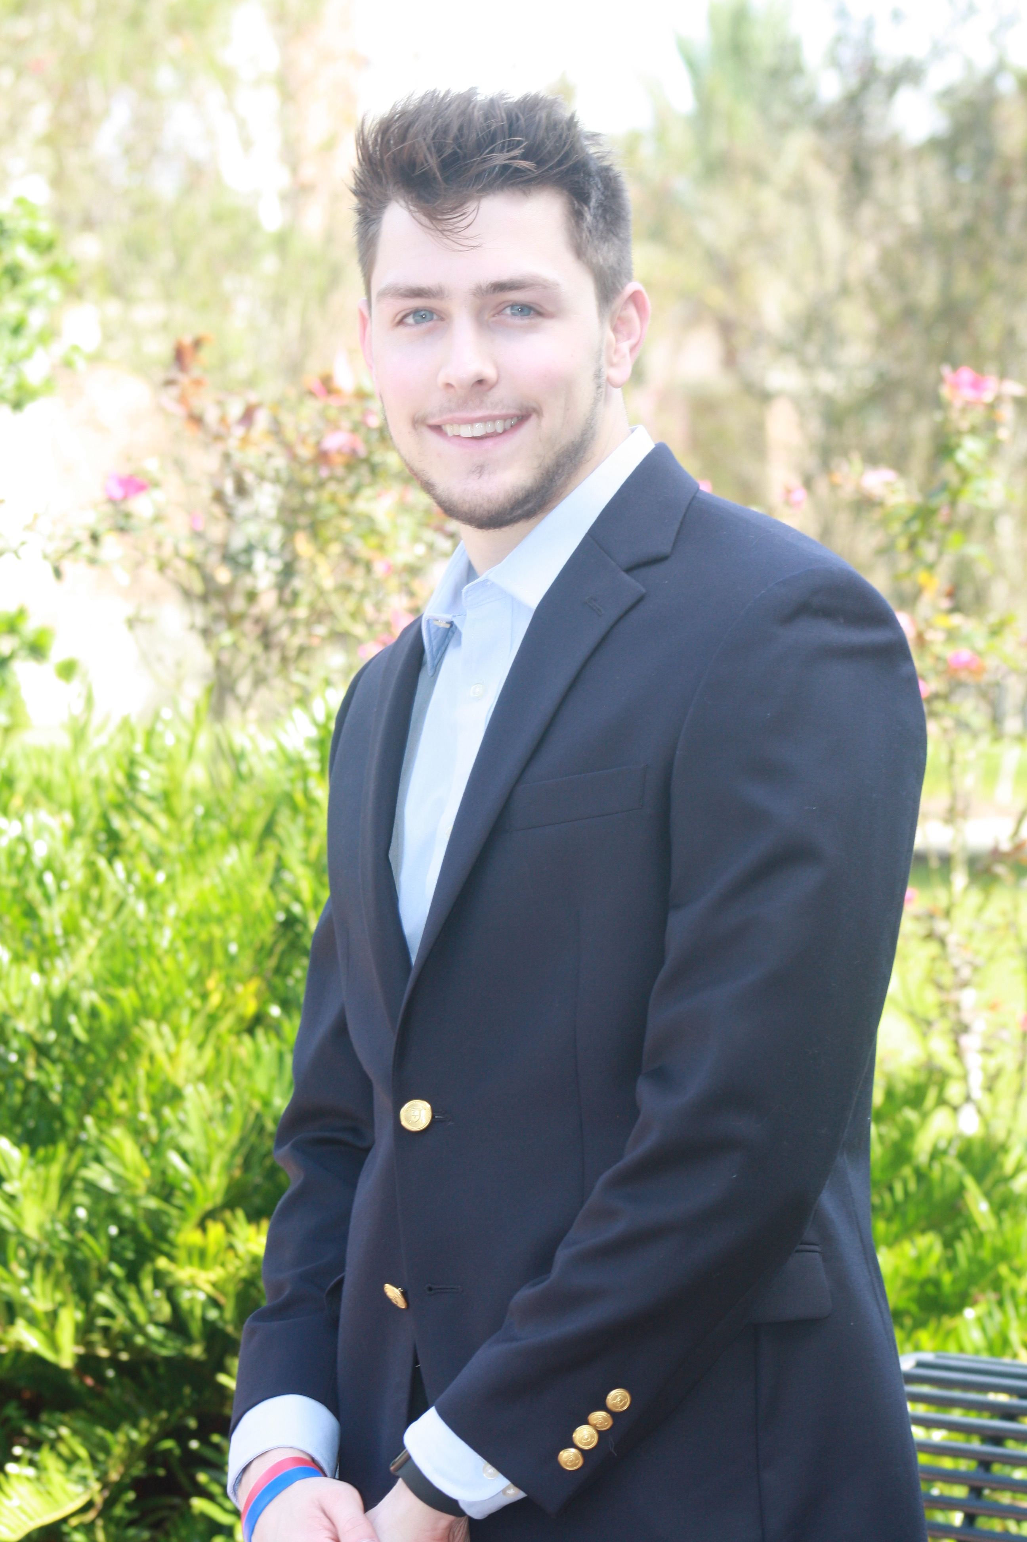
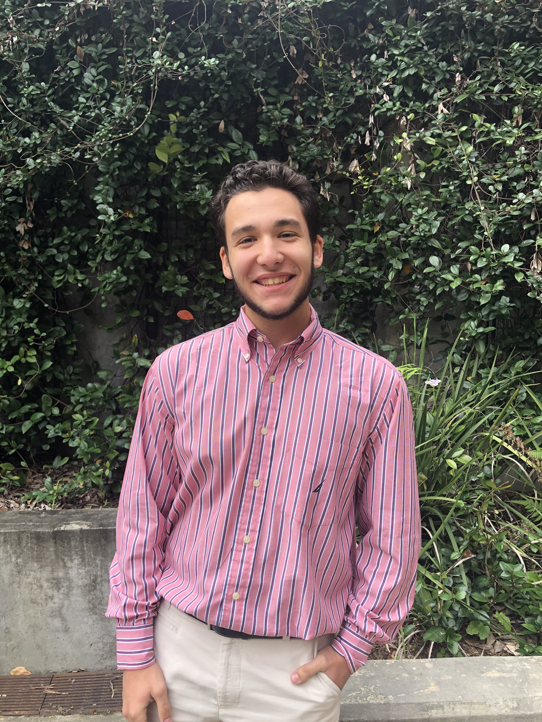
Team Introduction
Ebony Bland
Davis Goolsby
Garfield Murphy
Austin Bruen
Emilio Manzo
Ebony Bland

Slide 3
Project Scope
Key Goals
Markets
Background
Assumptions
Stakeholders
Davis Goolsby

Slide 4
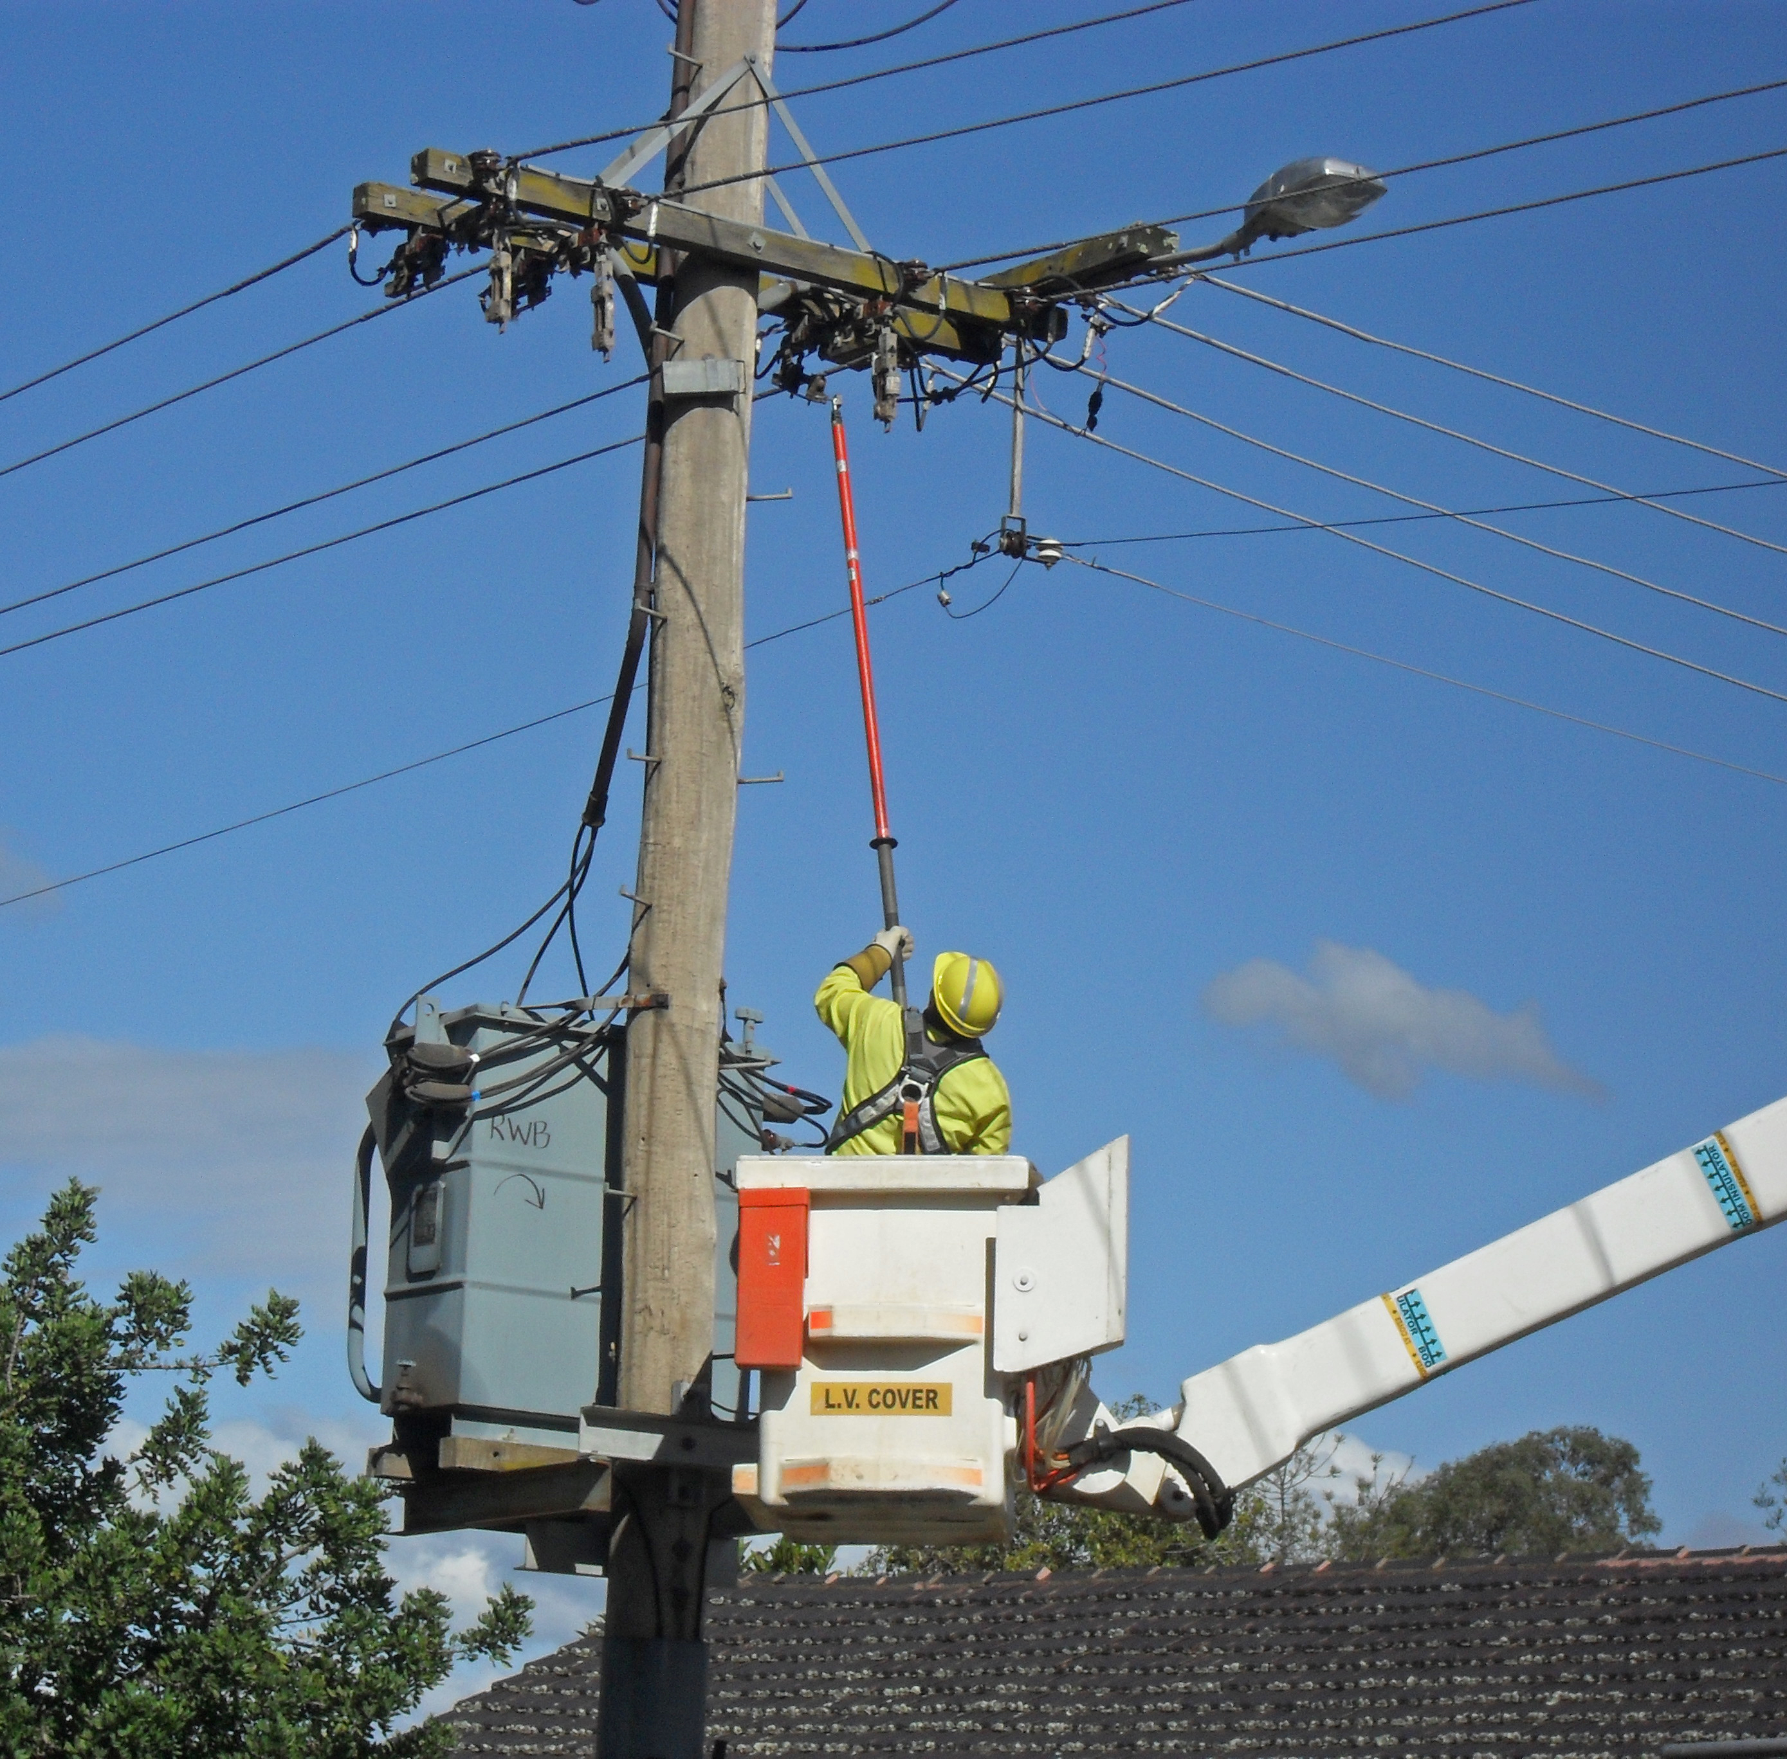
Brief Project Summary
Develop a device that is remotely controlled and can be operated to perform fuse switching operations for restoration purposes
Ebony Bland

Slide 5
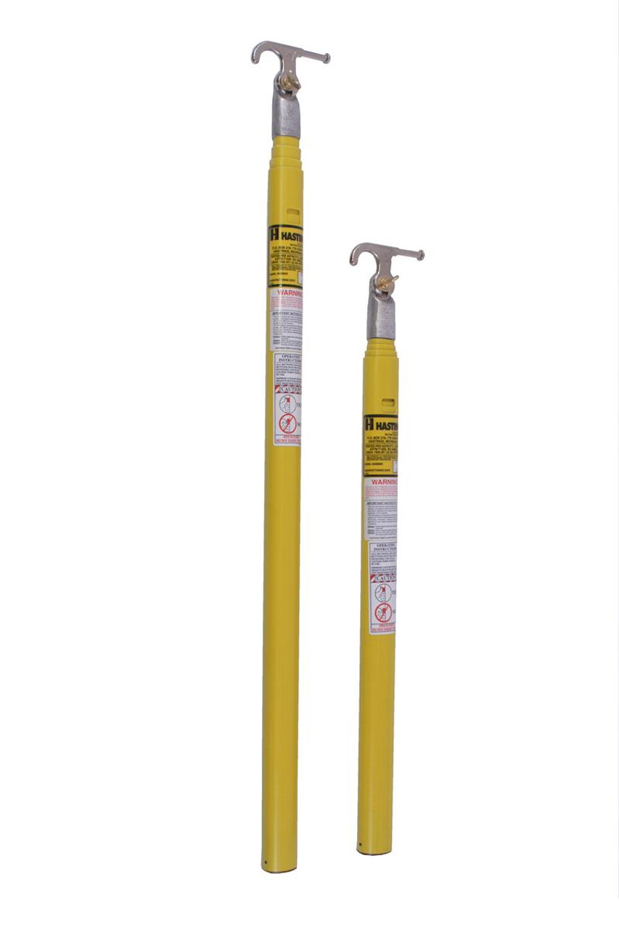
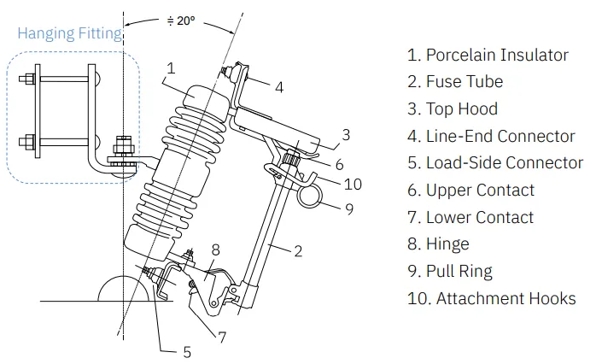
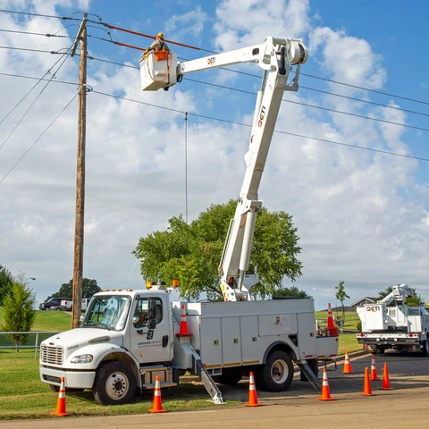
Background
Utility Fuses are used to protect equipment from damage in the event of over current
Current equipment used to perform process
Ebony Bland

Slide 6
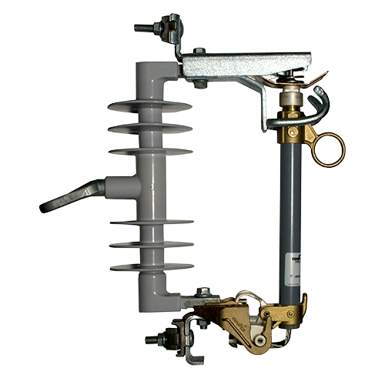




Key Goals
Fuse Switching and
Restoration
1
Easily Transportable
2
Easy Operation &
User Friendly
3
Davis Goolsby

Slide 7



Markets
Electric Companies
Public Safety
Primary Markets:
Secondary Markets:
Contractors
Construction
Municipalities
Davis Goolsby

Slide 8
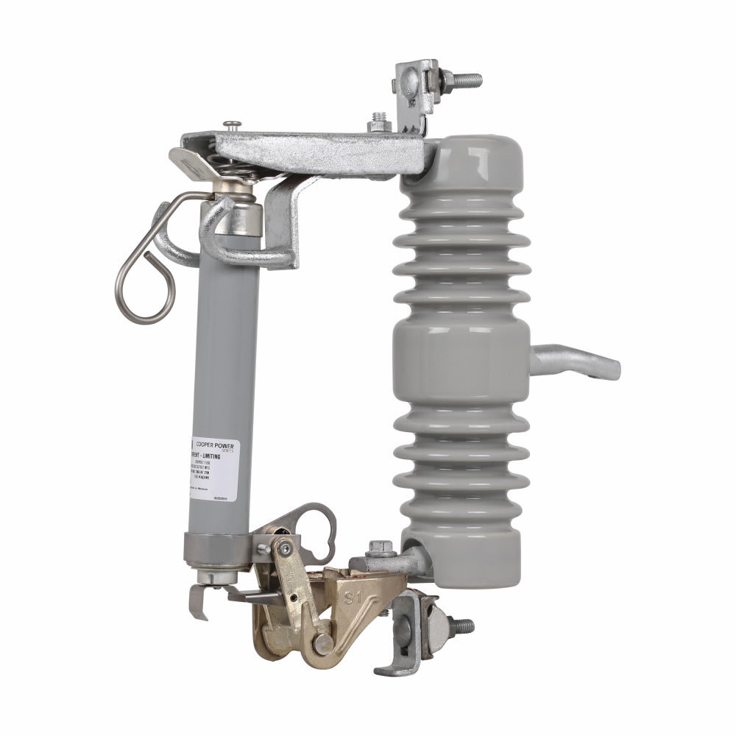
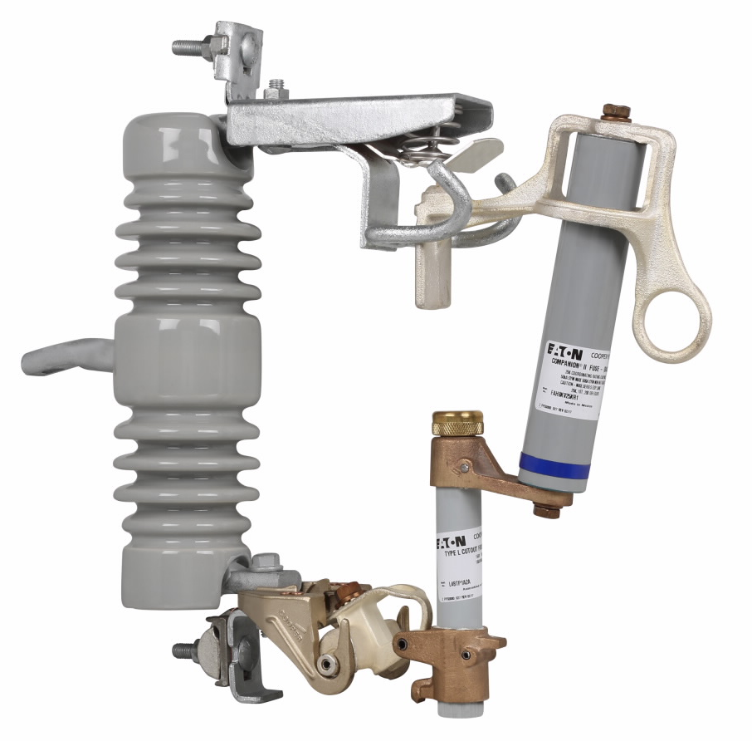
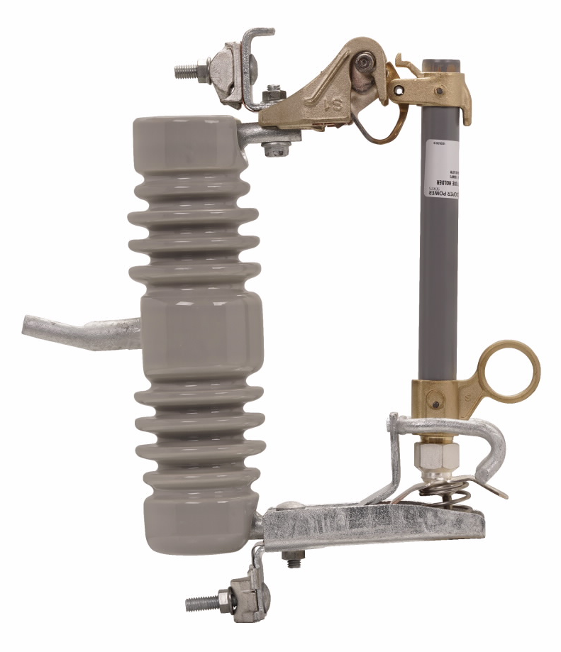
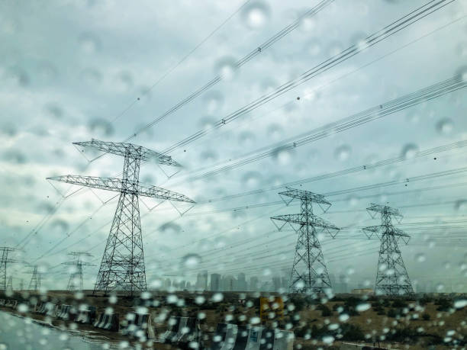
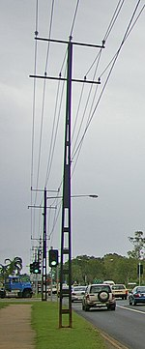
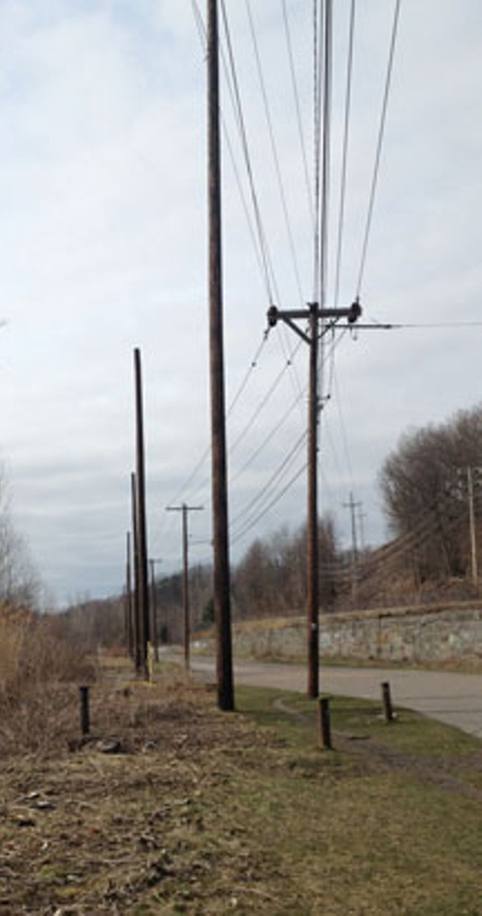
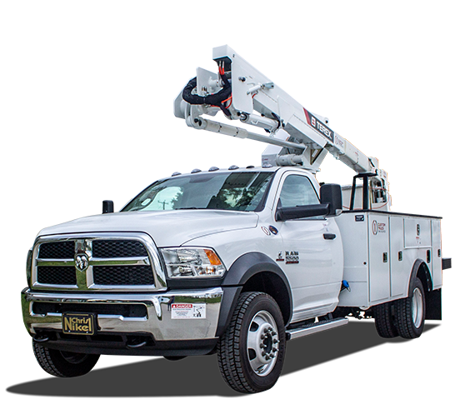

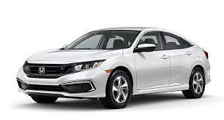
Assumptions
Fuse Types
Safe Weather Conditions
Pole Sizes
Transportation
Training
Davis Goolsby

Slide 9
Stakeholders
 | Investors | Decision-Makers | Advisers | Receivers
Sponsor | Florida Power and Light, NextEra Energy | Florida Power and Light, NextEra Energy | Scarlett Luis (Engineer at FPL) | Florida Power and Light, NextEra Energy
Manager | Scarlett Luis (Engineer at FPL) | Scarlett Luis (Engineer at FPL) | Dr. McConomy | Florida Power and Light, NextEra Energy
Experts | Florida Power and Light, NextEra Energy | Kyle Bush (FPL Project Manager) | Dr. Hruda | Florida Power and Light employed Operators
Operators | Florida Power and Light, NextEra Energy | Kyle Bush (FPL Project Manager) | Kyle Bush (FPL Project Manager) | Florida Power and Light employed Operators
Davis Goolsby

Slide 10

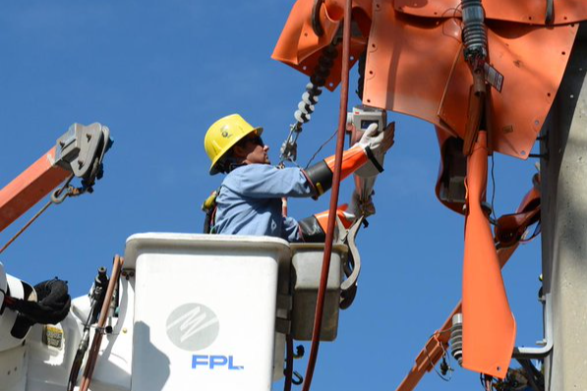
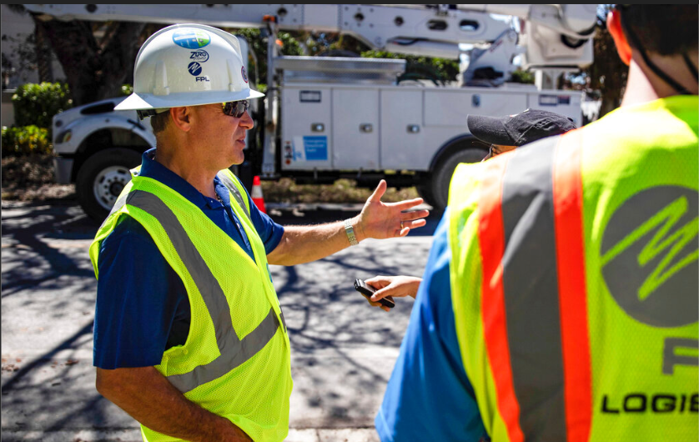
Who is the customer/sponsor?
Sponsor Florida Power and Light
Linesmen
Restoration Specialists
Ebony Bland

Slide 11




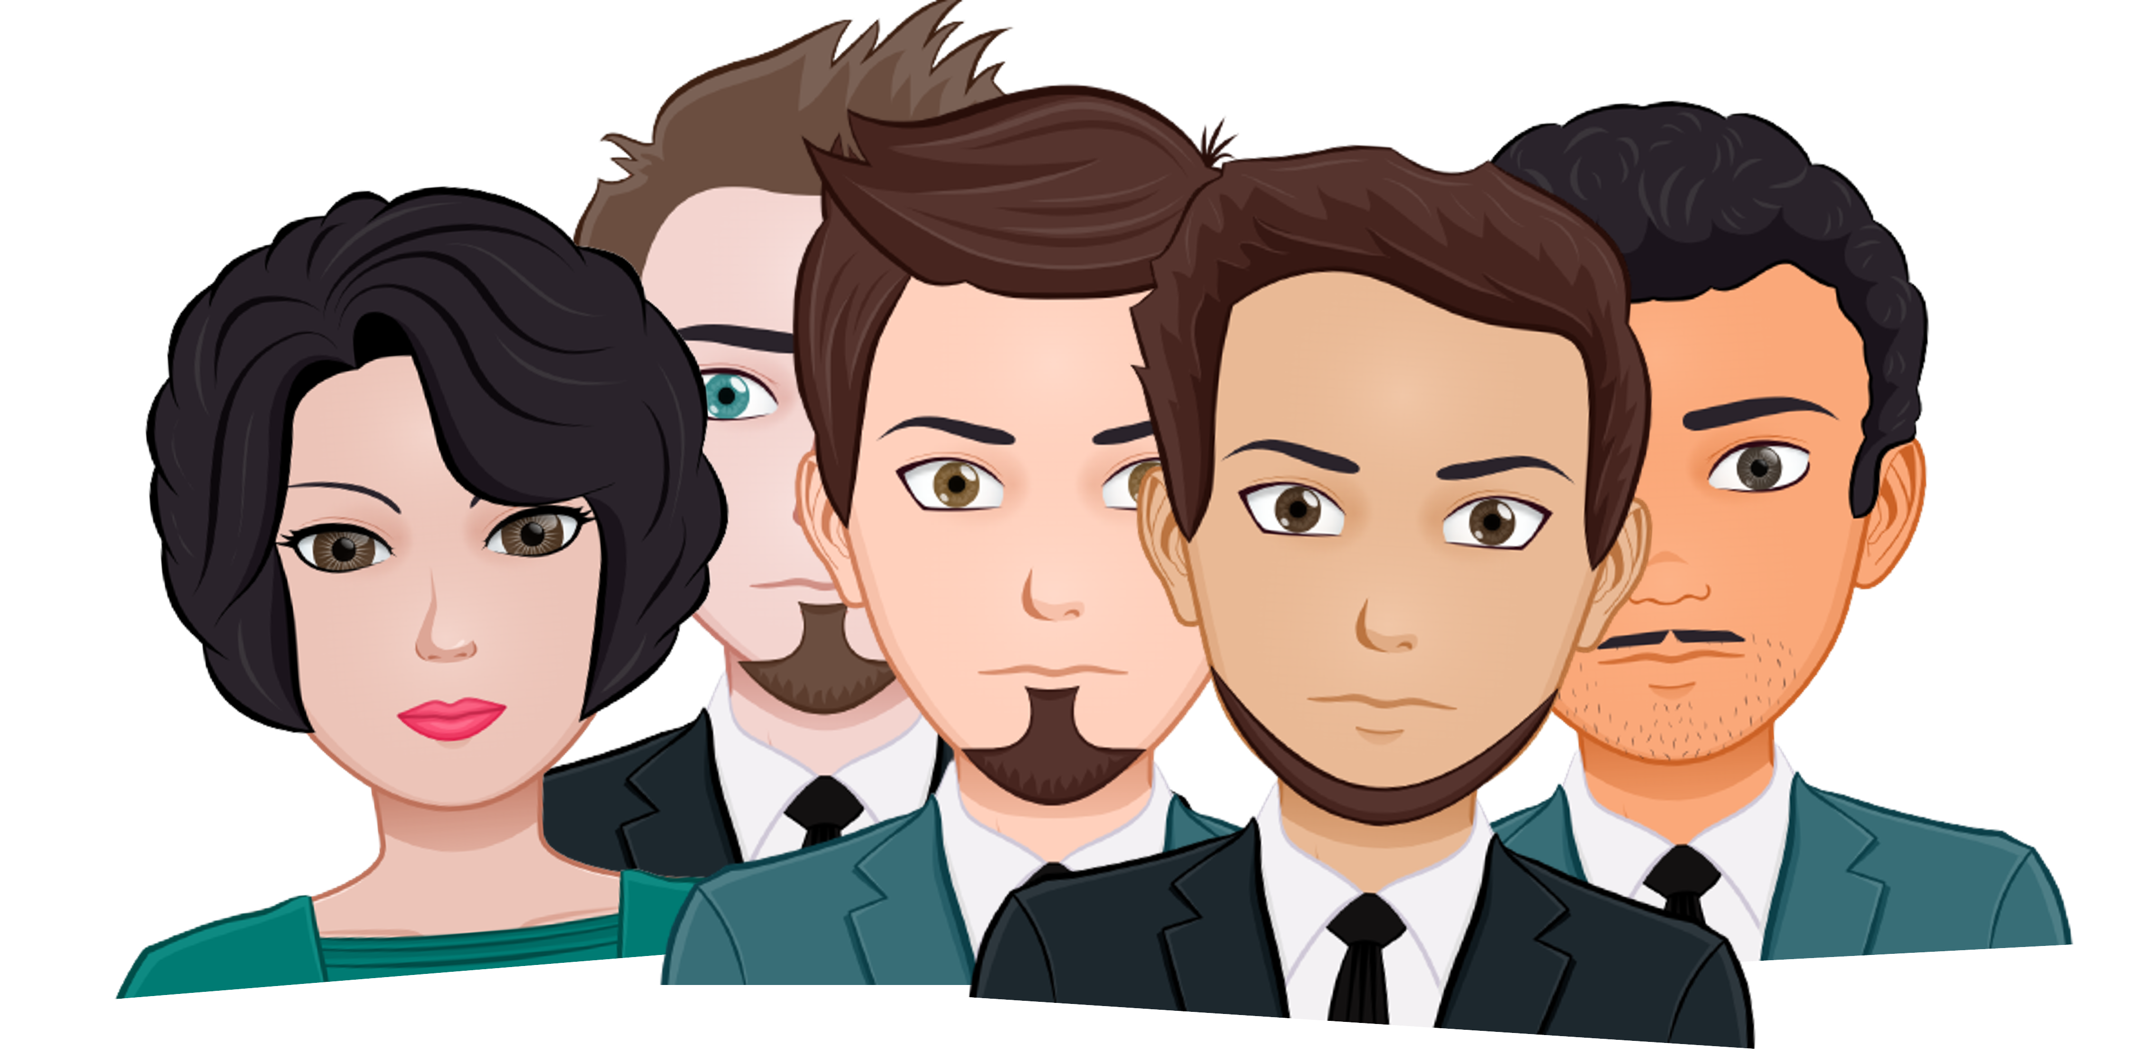
CUSTOMER NEEDS
Ebony Bland

Slide 12

CUSTOMER NEEDS
Questions | Statements | Interpreted Needs
Intended User? | Typical users are linemen and engineers doing field work. | The device needs to be easy operate to in a field environment.
Operating Environment ? | Residential areas. Design device for ideal weather conditions | Used in safe weather conditions
Current Dimensions of the Product? | Approximately 4 feet long when fully collapsed. | Device fits inside Bucket truck for transportation
Ebony Bland

Slide 13
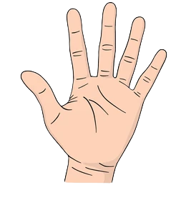
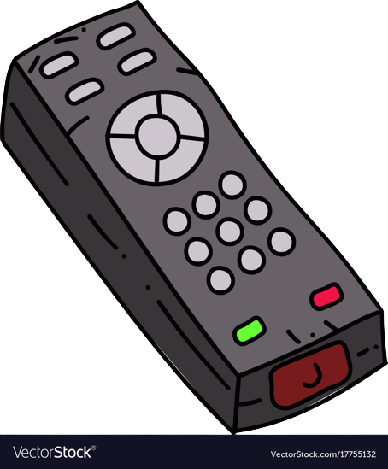
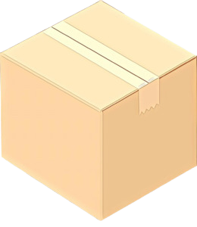
CUSTOMER NEEDS
- INTERPRETED NEEDS
Ebony Bland

Slide 14
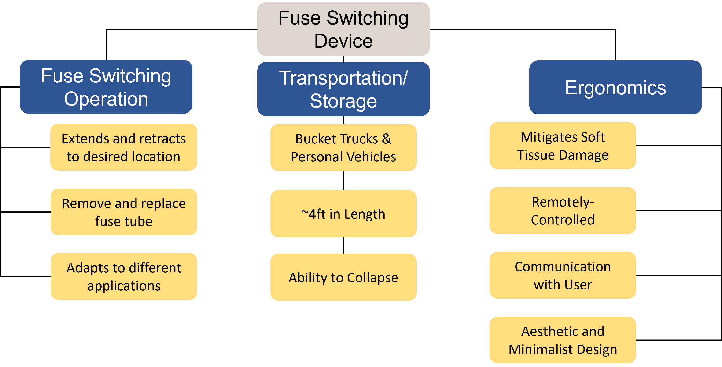
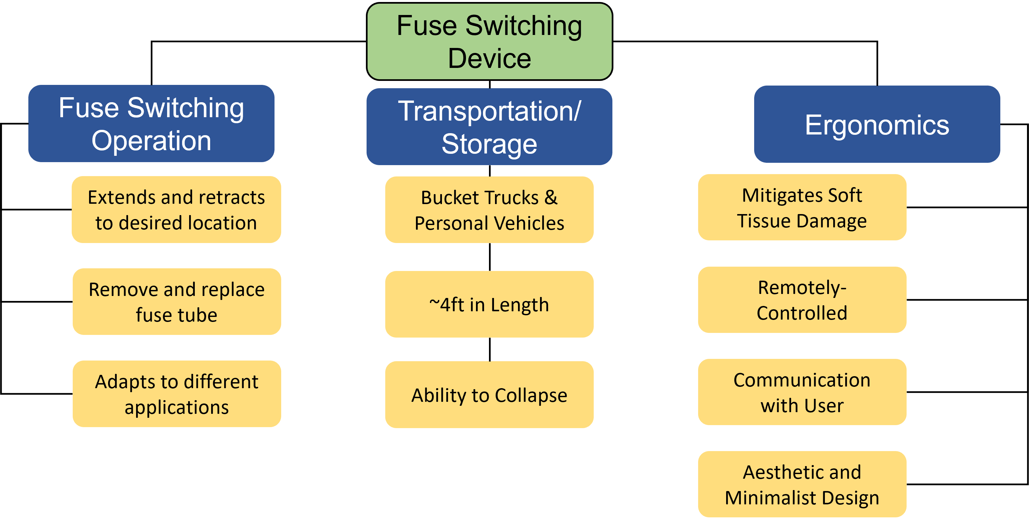
Functional Decomposition: Functions
Davis Goolsby
Fuse Switching Device
Fuse Switching Operation
Transportation/ Storage
Ergonomics
Extends and retracts to desired location
Bucket Trucks & Personal Vehicles
Mitigates Soft Tissue Damage
Remove and replace fuse tube
~4ft in Length
Remotely-Controlled
Adapts to different applications
Ability to Collapse
Communication with User
Aesthetic and Minimalist Design

Slide 15
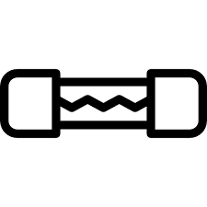
Functional Decomposition: Minor Functions
Fuse Switching Operation
Extends and retracts to desired location
Remove and replace fuse tube
Adapts to different applications
Davis Goolsby

Slide 16

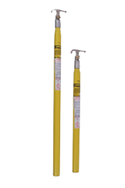
Functional Decomposition: Minor Functions
Transportation/Storage
Bucket Trucks & Personal Vehicles
~4ft in Length
Ability to Collapse
Davis Goolsby

Slide 17
Functional Decomposition: Minor Functions
Ergonomic
Mitigates Soft Tissue Damage
Remotely-Controlled
Communication with User
Aesthetic and Minimalist Design
Davis Goolsby

Slide 18
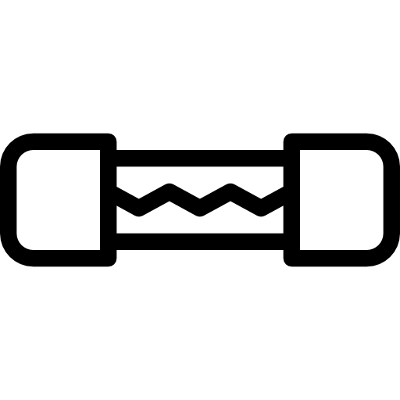

Functional Decomposition: Smart Integration
Has an Ergonomic Design
Fuse Switching Operation
Transportation
& Storage
Ergonomic
Extends/Descends
Automatic Operation
Considers Transportation/Storage
Reach inaccessible
areas
Compact Design
Performs Fuse Switching Operation
Davis Goolsby
Mitigates Soft Tissue Damage
Automate Some or All of Process
Compact Design
Transportable by Bucket Truck & Personal Vehicle
Ability to Extend, Retract, & Pivot
Reach Inaccessible Area

Slide 19






Future Work
Concept Generation
Concept Selection
Targets
Bill of Materials
Risk
Assessment
Spring
Plans
Davis Goolsby

Slide 20

Questions
Davis Goolsby

Slide 21
References
Brain, M. (n.d.). How Power Grids Work. Retrieved from Clark Science Center at Smith College: https://www.science.smith.edu/~jcardell/Courses/EGR220/ElecPwr_HSW.html#:~:text=Fuses%20must%20be%20replaced%20each,panel%20like%20the%20one%20above
Csanyi, E. (2013, January 28). How to manipulate energized conductors with hot stick. Retrieved from Electrical Engineering Portal: https://electrical-engineering-portal.com/manipulating-energized-conductors-with-hot-stick
Csanyi, E. (2020, October 12). How primary feeder, distribution transformer, fuses and service operate in radial networks. Retrieved from Electrical Engineering Portal: https://electrical-engineering-portal.com/primary-feeder-distribution-transformer-fuses-service
Eaton Corporation. (n.d.). Eaton Website. Retrieved from Fuses: fundamentals of fuses: https://www.eaton.com/us/en-us/products/medium-voltage-power-distribution-control-systems/utility-fuses/fuses--fundamentals-of-fuses.html
Hastings Hot Line Tools & Equipment. (2021, March). Hastings Catalog. Retrieved from Hastings Website: https://www.hfgp.com/fb-catalog/
King-Homan, L. (2020, August 3). How Does That Work? Hot Stick. Retrieved from The Wire: Energy news from Omaha Public Power District: https://oppdthewire.com/hot-stick-how-works-2020-oppd/
Davis Goolsby

Slide 22
BONUS SLIDES
Davis Goolsby

Slide 23
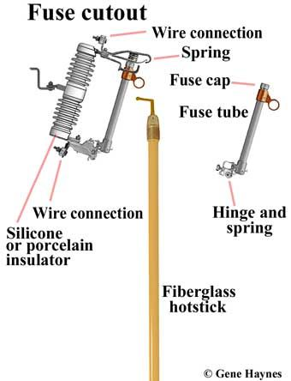
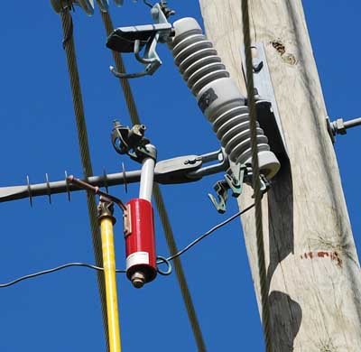
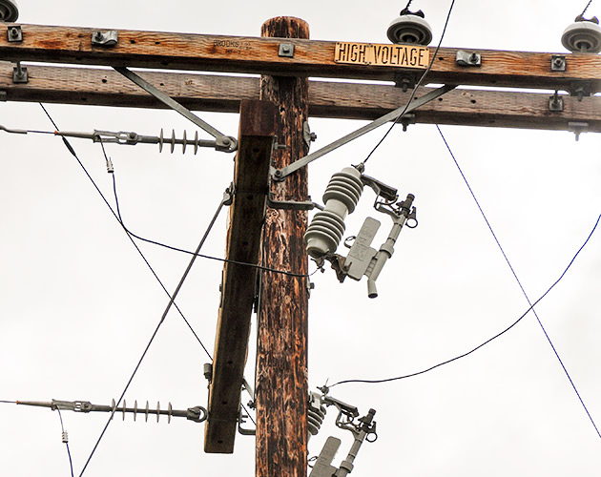
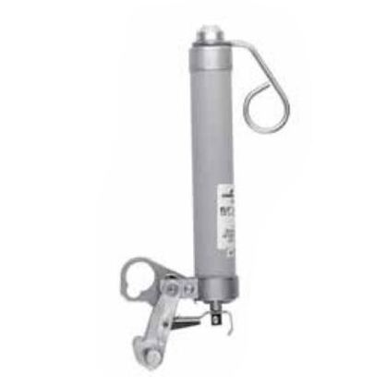
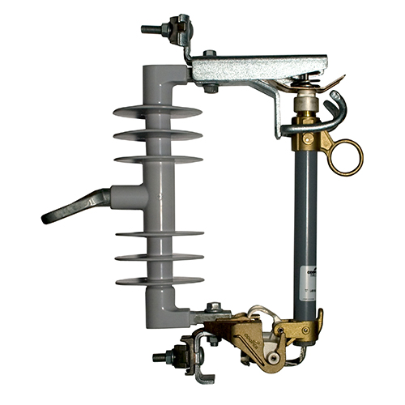
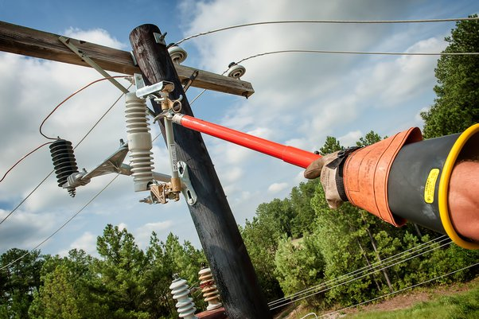
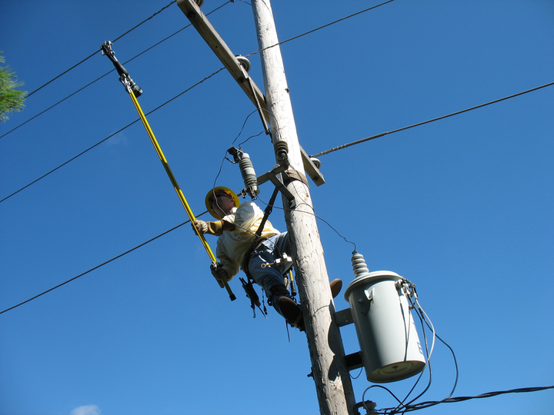
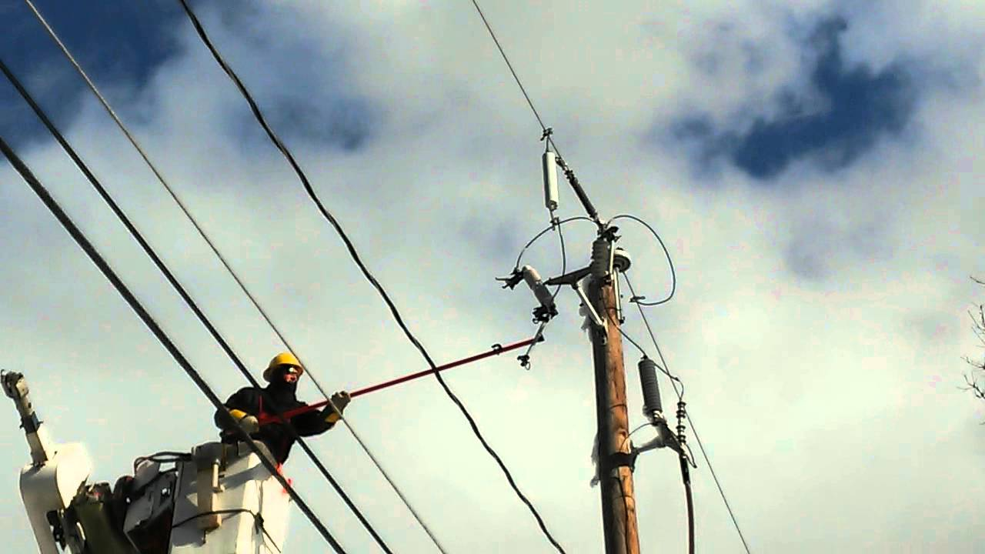

Slide 24
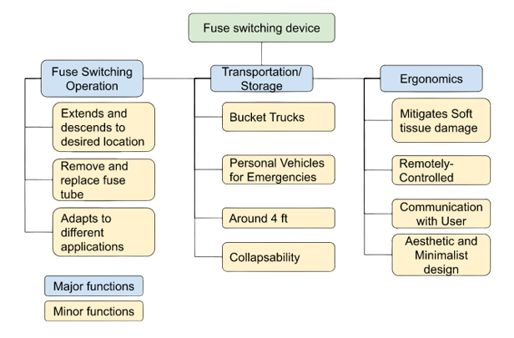
Functional Decomposition: Major Functions
Fuse Switching Device
Fuse switching Operation
Transportation/ Storage
Ergonomics
Hierarchy Chart
Davis Goolsby

Slide 25
Functional Decomposition
Considers Transportation/Storage
Bucket Trucks & Personal Vehicles
~4ft in Length
Ability to Collapse
Davis Goolsby

Slide 26
CROSS REFERENCE TABLE
Function Decomposition Cross Reference Chart
Function | Fuse Switching Operation | Transport & Storage | Ergonomics
Reach inaccessible areas | X | X | X
Mitigate soft tissue damage and limits physical strain |  | X | X
Can be transported by personal vehicles or bucket truck |  | X
Function Decomposition Cross Reference Chart
Function | Fuse Switching Operation | Transport & Storage | Ergonomics
Compact device design |  | X | X
Automatic operation of all or some of the fuse switching process | X |  | X
Device that can extend/retract and pivot to perform fuse switching process | X

Slide 27
Fuse Switching Device
Fuse Switching Operation
Transportation/ Storage
Ergonomics
Extends and retracts to desired location
Bucket Trucks & Personal Vehicles
Mitigates Soft Tissue Damage
Remove and replace fuse tube
~4ft in Length
Remotely-Controlled
Adapts to different applications
Ability to Collapse
Communication with User
Aesthetic and Minimalist Design

Slide 28
Functional Decomposition
Mitigates Soft Tissue Damage
Automate Some or All of Process
Performs Fuse Switching Operation
Considers Transportation/Storage
Compact Design
Transportable by Bucket Truck & Personal Vehicle
Has an Ergonomic Design
Ability to Extend, Retract, & Pivot
Reach Inaccessible Area
Davis Goolsby

Slide 29
Functional Decomposition: Major Functions
Fuse Switching Device
Ergonomics
Fuse switching Operation
Transportation/ Storage
Hierarchy Chart
Davis Goolsby
Fuse Switching Device

Slide 30
Functional Decomposition: Major Functions
Fuse Switching Device
Fuse switching Operation
Ergonomics
Transportation/ Storage
Hierarchy Chart
Davis Goolsby

Slide 31
Functional Decomposition
Performs Fuse Switching Operation
Extends and retracts to desired location
Remove and replace fuse tube
Adapts to different applications
Davis Goolsby

Slide 32
Functional Decomposition
Considers Transportation/Storage
Bucket Trucks & Personal Vehicles
~4ft in Length
Ability to Collapse
Davis Goolsby

Slide 33
Functional Decomposition
Has an Ergonomic Design
Mitigates Soft Tissue Damage
Remotely-Controlled
Communication with User
Aesthetic and Minimalist Design
Davis Goolsby

Slide 34
Functional Decomposition
Mitigates Soft Tissue Damage
Automate Some or All of Process
Performs Fuse Switching Operation
Considers Transportation/Storage
Compact Design
Transportable by Bucket Truck & Personal Vehicle
Has an Ergonomic Design
Ability to Extend, Retract, & Pivot
Reach Inaccessible Area
Davis Goolsby

Slide 35
Future Work
Concept Generation
Concept Selection

